Slide 1
B.Com.II
Money & Financial System
Evolution of Money
Presented by
I/C Prin. Dr. Shivaji Pawar
Head Deptt. Of Commerce
Arts and Commerce College Kasegaon

Slide 2
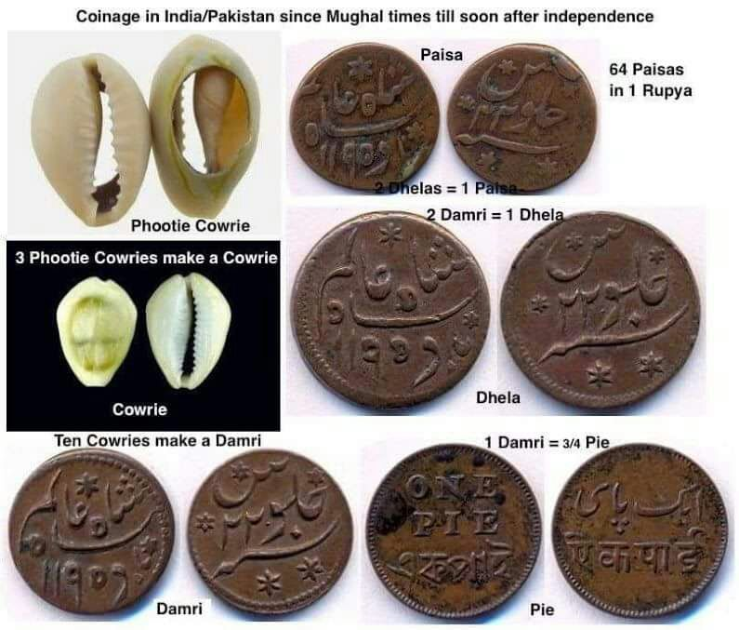

Slide 3
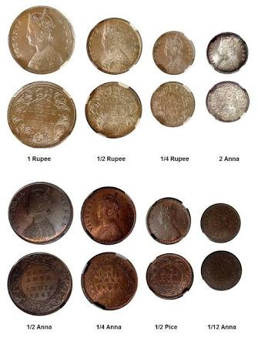

Slide 4
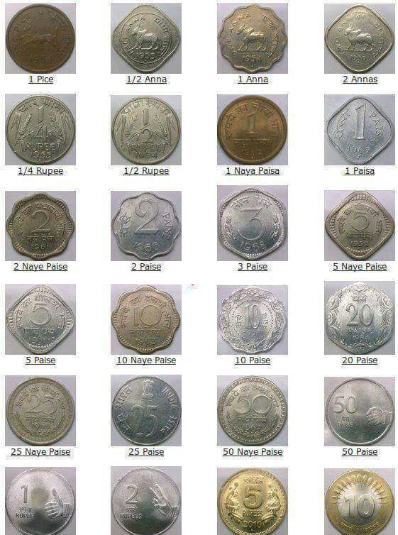

Slide 5
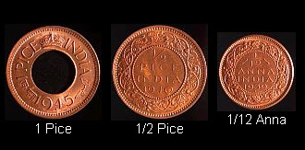
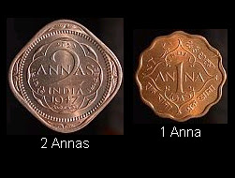

Slide 6
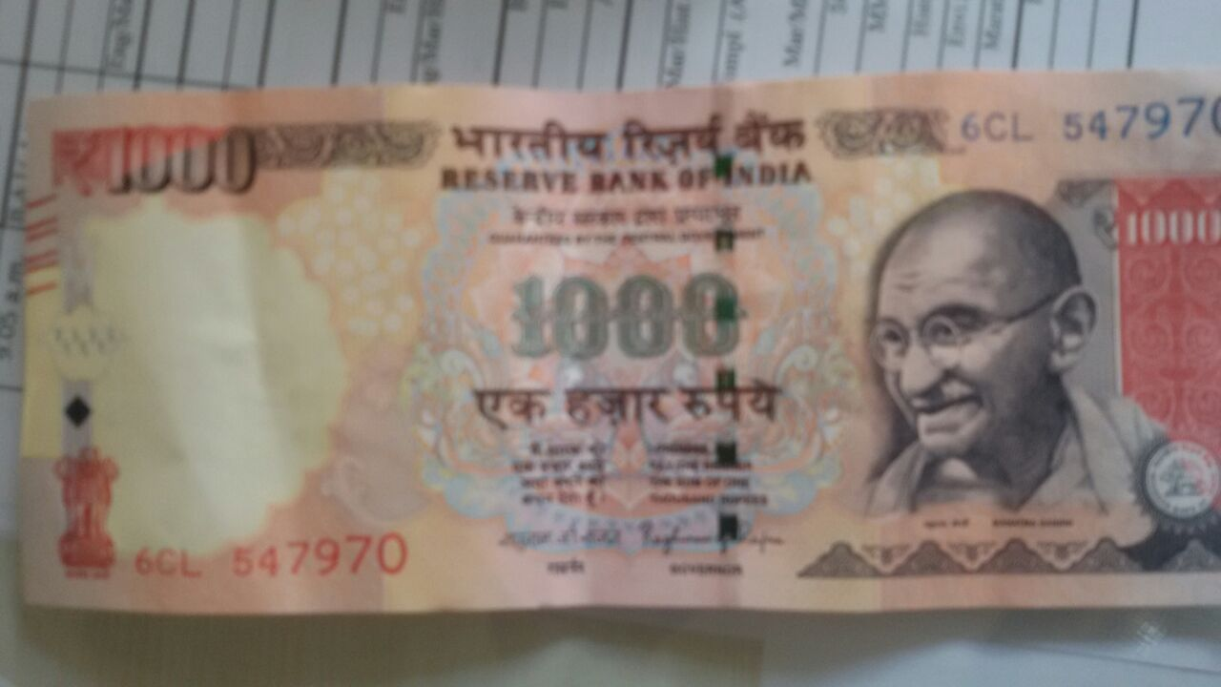

Slide 7
Evolution of Money

Slide 8
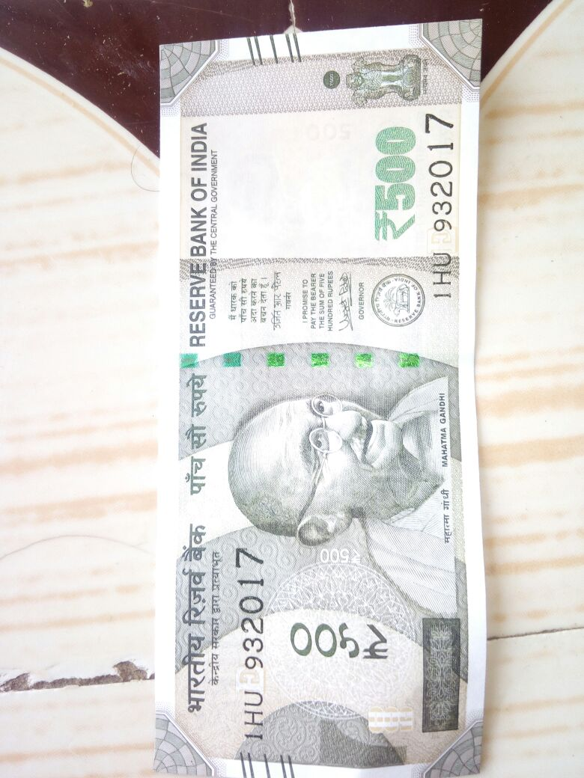

Slide 9
Demonetization
Need,
Importance,
Options,
System etc

Slide 21
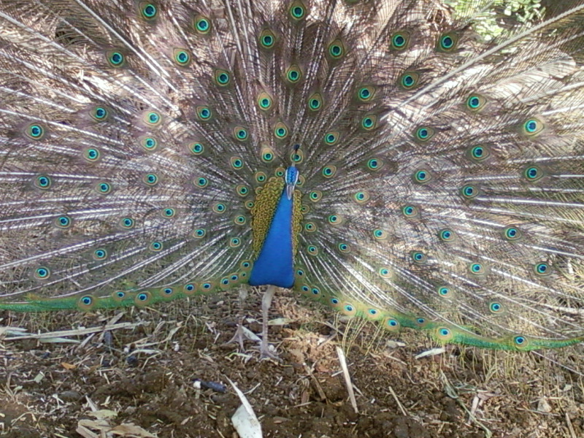
Thank
You

