Slide 1
Well Come to
B.Com. II
Deptt. Of Commerce
Arts and Commerce College Kasegaon

Slide 2
Women Entrepreneurs in India
Prepared By : Dr. Shivaji R.Pawar
M.Com.,M.Phil.,G.D.C.& A.,Ph.D.
Head Dept. of Commerce,
Arts and Commerce College Kasegaon
Mob:8275377365 Email: srpawar65@gmail.com

Slide 3
Indra Nooyi
Indra Krishnamurthy Nooyi
Born October 28, 1955 is the
Chairperson and Chief Executive Officer
(CEO) of PepsiCo, one of the worlds
leading food and beverage companies.

Slide 4
Priya Paul
Chairperson of Appeejay
Priya Paul (born 1967), is a prominent woman entrepreneur of India, and currently the Chairperson of Appeejay The Park Hotels chain of boutique hotels. She joined the company, after finishing her studies in Economics at the Wellesley College (US) working under her father, as Marketing Manager at the Park Hotel, Delhi, at the age of 22.

Slide 5
Simone Tata
Chairperson Lakme
With her visions, she changed a small unknown cosmetics company, one of the subsidiaries of Tata Oil Mills, intoone of the leading cosmetic companies of India. Lakme changed the face of Indian fashion and cosmetics forever.

Slide 6
Vidya Manohar Chhabria
Chairperson Jumbo Group, Dubai
The wife of late Manohar Rajaram Chhabria,is now leading Jumbo Group, a Dubai based $1.5 billion business conglomerate. She became chairperson of the company after the death of her husband in 2002.

Slide 7
Eminent Women
Sulajja Firodia Motwani
Sulajja Firodia Motwani is Joint
Managing Director of Kinetic Engineering Ltd,
Ekta Kapoor
Creative Head of Balajji Telefilms, is the daughter of actor Jeetendra,
and sister of actor Tushar Kapoor.

Slide 8
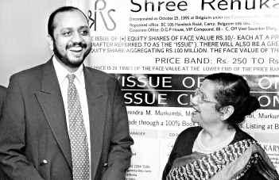
Ms Vidya Murkumbi
Ms Vidya Murkumbi, Executive Chairperson, Shree Renuka Sugars Ltd,
with Mr Narendra Murkumbi, Managing Director

Slide 9
Shree Renuka Sugars
Type Public (BSE: 532670NSE: RENUKA)
Industry Sugar
Founded 1998
Founder(s) Narendra Murkumbi & Vidya Murkumbi
Headquarters Mumbai, Maharashtra, India
Area served Belgaum
Key people Narendra Murkumbi, MD
Revenue 2,239.80 crore (US$425.56 million)
Profit 143.50 crore (US$27.27 million)
Owner(s) Narendra Murkumbi

Slide 10
Shree Renuka Sugars is India's largest sugar refiner and ethanol producer based in Mumbai, Maharashtra,with refining capacity of 4000 tonnes/day and distillery capacity of 600 Kilo liter/day. It has 21% market share in India's fuel ethanol market and has an aggressive growth plan of increasing its ethanol production capacity to 900 Kilo liter/day by Dec 2009. It also accounts for 20% of India's international sugar trade.

Slide 11
Acquisitions
On 24 February 2010, Shree Renuka Sugars (SRSL) has signed a deal with Grupo Equipav for an investment of BRL600m leading to a majority, controlling equity stake in Equipav Acucar e Alcool (Equipav), a sugar/ethanol company in Brazil.The deal is subject to approval of an acceptable debt restructuring package by the lenders to the company and certain other conditions customary to such transactions. Closing is expected in 40 days. Shree Renuka Sugars creates one of the largest Sugar/Ethanol Groups in Brazil with Equipav Deal. Indian credit rating agency ICRA has maintained the long term rating of [ICRA]A+ on the company.
Renuka sugars also owns a team in KSCA's Belgaum Premier League T20. The name of the team is Renuka Royals.

Slide 12
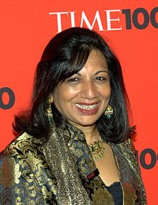
Kiran Mazumdar-Shaw
Born March 23, 1953 )
(age 58) Bangalore, India
Residence Bangalore, India
Occupation Chairperson of Biocon
Education Mount Carmel College, Bangalore University
Net worth US$900 million (2010)

Slide 13
Conti….
''Kiran Mazumdar-Shaw' (Kannada: born 23 March 1953) is an Indian entrepreneur. She is the Chairman & Managing Director of Biocon Limited a biotechnology company based in Bangalore (Bangaluru), India.
Profile
Kiran Mazumdar-Shaw was born on March 23, 1953 in Bangalore, India
Mazumdar-Shaw completed her schooling from the city’s Bishop Cotton Girl’s High School (1968). She wanted to join medical school but instead took up biology and completed her BSc Zoology Honours course from Mount Carmel College, Bangalore University (1973). She later did her post-graduation in Malting and Brewing from Ballarat College, Melbourne University (1975).

Slide 14
She worked as a trainee brewer in Carlton and United Breweries, Melbourne and as a trainee maltster at Barrett Brothers and Burston, Australia. She also worked for some time as a technical consultant at Jupiter Breweries Limited, Calcutta and as a technical manager at Standard Maltings Corporation, Baroda between 1975 and 1977. She started Biocon in 1978 and spearheaded its evolution from an industrial enzymes manufacturing company to a fully integrated bio-pharmaceutical company with a well-balanced business portfolio of products and a research focus on diabetes, oncology and auto-immune diseases.
She also established two subsidiaries: Syngene (1994) to provide development support services for discovery research and Clinigene (2000) to cater to clinical development services. Her pioneering work in the sector has earned her several awards, including the prestigious Padma Shri (1989) and the Padma Bhushan (2005) from the government of India. She was recently named among TIME magazine’s 100 most influential people in the world. She is on the Forbes list of the world’s 100 most powerful women and the Financial Times’ top 50 women in business list.

Slide 15
Conti….
Biocon
In 1978, she joined Biocon Biochemicals Limited, of Cork, Ireland as a Trainee Manager. In the same year she started Biocon in the garage of her rented house in Bangalore with a seed capital of Rs. 10,000.
Initially, she faced credibility challenges because of her youth, gender and her untested business model. Not only was funding a problem as no bank wanted to lend to her, but she also found it difficult to recruit people for her start-up. With single-minded determination she overcame these challenges only to be confronted with the technological challenges associated with trying to build a biotech business in a country facing infrastructural woes. Uninterrupted power, superior quality water, sterile labs, imported research equipment, and advanced scientific skills were not easily available in India during the time.
She is responsible for steering Biocon on a trajectory of growth and innovation over the years. Within a year of its inception, Biocon became the first Indian company to manufacture and export enzymes to USA and Europe. In 1989, Biocon became the first Indian biotech company to receive US funding for proprietary technologies. In 1990, she upgraded Biocon’s in-house research program, based on a proprietary solid substrate fermentation technology.

Slide 16
In the same year, she incorporated Biocon Biopharmaceuticals Private Limited to manufacture and market a select range of biotherapeutics in a joint venture with the Cuban Centre of Molecular Immunology.
In 2004, she decided to access the capital markets to develop Biocon’s pipeline of research programs. Biocon’s IPO was oversubscribed 32 times and its first day at the bourses closed with a market value of $1.11 billion, making Biocon only the second Indian company to cross the $1-billion mark on the first day of listing.[2]
She entered into more than 2,200 high-value R&D licensing and other deals within the pharmaceuticals and bio-pharmaceutical space between 2005 and 2010 and helped Biocon expand its global footprint to emerging and developed markets through acquisitions, partnerships and in-licensing. Her belief that healthcare needs can only be met with affordable innovation has been the driving philosophy that has helped Biocon manufacture and market drugs cost-effectively.
In 2007-08, a leading US trade publication, Med Ad News, ranked Biocon as the 20th leading biotechnology companies in the world and the 7th largest biotech employer in the world. Biocon also received the 2009 BioSingapore Asia Pacific Biotechnology Award for Best Listed Company.[2]
Today, thanks to her leadership, Biocon is building cutting-edge capabilities, global credibility and global scale in its manufacturing and marketing activities. It has Asia’s largest insulin and statin facilities as also the largest perfusion-based antibody production facilities.

Slide 17
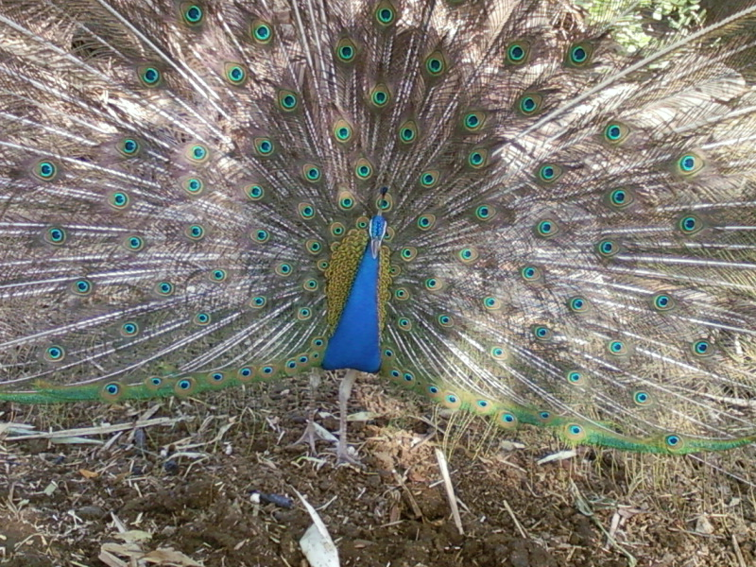
Thank
You

